Slide 1




Next Gen Employability Program
Faculty Development Program
Notes:
In this slide, the trainers would be making the audience aware about the program and need of this program.

Slide 2

DISCLAIMER
The content is curated from online/offline resources and used for educational purpose only
Notes:
Speaker would be briefing the students that this content has been prepared for the educational purpose only and is referred from multiple sites which are cited in the last.​
---------------------------------------------------​
A disclaimer is a statement or notice that is intended to clarify, limit, or provide information about the scope, limitations, or potential risks associated with certain actions, information, products, services, or content.

Slide 3

Content
Introduction
Need for Generative AI in Web Development
Generative AI Overview
Target Domain Requirements
Key functionalities typically needed in E-commerce apps
Tools and Technologies Used
Use Case Walkthrough
Benefits and Challenges
Conclusion

Slide 4

Case Study 2 - E-commerce
Introduction
E-commerce relies heavily on dynamic and personalized content.
Manual content creation is time-consuming and repetitive.
Generative AI enables automatic generation of product descriptions, banners, and more.
Helps businesses scale faster with lower cost and effort.
Lays the foundation for AI-powered theme-based web-page design.
Notes:
E-commerce platforms are under constant pressure to deliver dynamic, personalized experiences to users. This involves regularly updating product content, promotional banners, themes, and layouts — all of which require significant manual effort and time.
Generative AI solves this problem by automating content generation. Whether it is creating product descriptions for thousands of items, designing visual themes, or generating promotional messages, generative AI can produce consistent and brand-aligned output at scale.

Slide 5
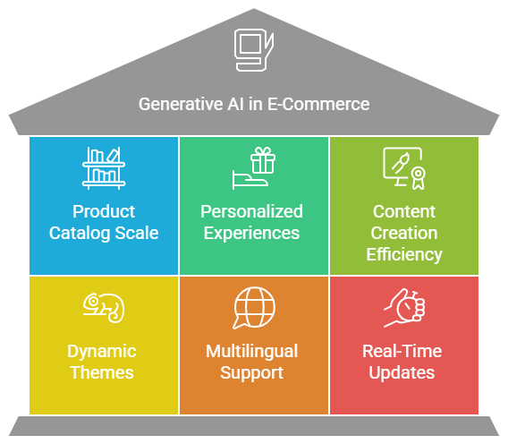
Case Study 2 - E-commerce
Need for Generative AI in E-Commerce
Growing scale of product catalogs and frequent updates.
Demand for personalized customer experiences.
Manual content creation is costly, slow, and inconsistent.
Generative AI ensures faster content generation with brand consistency.
Supports dynamic themes, multilingual content, and real-time updates.
Source :
AI-Generated
Notes:
Let us now understand why generative AI has become essential in the E-commerce space.
E-commerce businesses deal with thousands of products, and each product needs descriptions, tags, visuals, and promotional content. These also need to be updated regularly to reflect stock changes, sales events, or seasonal themes.
Doing all of this manually is not only time-consuming but also introduces inconsistencies in tone, style, and accuracy.
Generative AI models can automate this process. They can generate high-quality product descriptions, promotional taglines, even language translations — all at scale. This leads to faster content updates, cost savings, and a consistent brand voice.
AI also enables dynamic customization, such as changing the theme of a webpage for festivals or user segments — something that's becoming increasingly common in E-commerce.

Slide 6

Case Study 2 - E-commerce
Generative AI Overview
A subset of AI that creates new content from data.
Uses models like Large Language Models (LLMs) and diffusion models.
Generates text, images, code, and more.
Learns patterns from training data and mimics them.
Common tools: ChatGPT, Copilot, Gemini, etc.
Source :
https://www.iconpacks.net/icons/free-icons-6/free-generative-artificial-intelligence-icon-22109-thumb.png
Notes:
Generative AI refers to a category of artificial intelligence that can create new content — not just analyze or classify existing data. This includes generating text, images, videos, and importantly, code.
The most popular example is Large Language Models, such as GPT, which can understand and respond to natural language prompts.
For web development, this means we can describe what we want in plain English — such as "create a form to collect user income details" — and the model generates the appropriate HTML or Python code.
This makes it possible to prototype interfaces or logic without deep coding knowledge, allowing both faculty and students to focus on solving domain-specific problems instead of struggling with syntax.

Slide 7
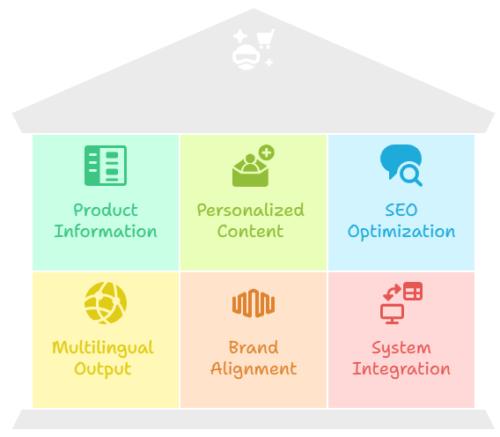
Case Study 2 - E-commerce
Key Domain Requirements
Accurate and consistent product information.
Personalized and SEO-optimized content.
Multilingual and region-specific output.
Visual and thematic alignment with brand identity.
Fast integration with existing E-commerce systems.
Source :
AI-Generated
Notes:
When applying generative AI in E-commerce, it is important to understand the specific domain requirements that must be addressed.
First, the generated content must be accurate and consistent, especially for product specifications, pricing, and stock status. Inaccurate content can lead to customer dissatisfaction or even legal issues.
Second, the content should be personalized and optimized for search engines (SEO). This increases visibility and engagement.
Third, platforms operating in multiple regions need multilingual support and cultural relevance in their content.
Fourth, the generated output — be it text or visuals — must match the brand’s tone and design themes. For example, luxury brands need a different style than budget-friendly platforms.
Finally, any generative solution should easily integrate with existing systems like CMS, inventory databases, or front-end frameworks to ensure seamless deployment.

Slide 8


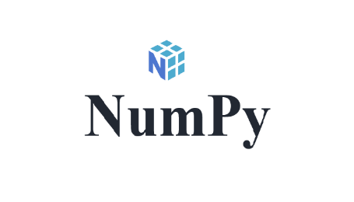

Case Study 2 - E-commerce
Tools and Technologies used
Python: Primary language for backend logic and data handling.
Streamlit: Lightweight web app framework for interactive UI.
GitHub: For code versioning, collaboration, and app deployment.
Generative AI Tools: ChatGPT / Copilot / Gemini for code generation and debugging.
Pandas, NumPy, Matplotlib: For data processing and visualization.
Source :
Google
Notes:
Discuss the tools and technologies used to build an application.
Python: Python is the backbone of our project. It handles the core logic, processes the data, and controls what happens behind the scenes. We chose Python because it is beginner-friendly, has a vast ecosystem of libraries, and is commonly used in AI and data projects.
Streamlit: Streamlit allows us to quickly convert Python scripts into interactive web apps. It is perfect for non-web developers who still want to create clean, modern UIs without touching HTML or CSS. Just a few lines of Python code are enough to build full dashboards or interfaces.
GitHub: We use GitHub for version control, so every change in the code is tracked. It also supports team collaboration—multiple people can work on the same project. Moreover, Streamlit apps can be deployed directly from GitHub repositories to Streamlit Community Cloud.
Generative AI Tools: Tools like ChatGPT, GitHub Copilot, or Gemini helped us write and debug code faster. Instead of writing every line from scratch, we described what we needed and let the tools generate code suggestions. This saved time and helped us avoid common errors.
Pandas, NumPy, Matplotlib: These are standard Python libraries used in almost every data project. Pandas and NumPy helped us manipulate data—like filtering, sorting, and cleaning. Matplotlib allowed us to create basic visualizations, which we later integrated into our Streamlit app.

Slide 9

Hands-on Activity
Building an AI-Powered E-Commerce Landing Page
Notes:
Sample Prompt:
Prompt for E‑Commerce Landing Page
"Generate a modern e-commerce landing page using HTML, CSS, and JavaScript. It should have a sticky top navigation bar with a logo and three links, followed by a hero section with a shopping theme, a big heading, a short description, and a button that scrolls to a features section. The features section should show three cards in a responsive grid describing AI-powered recommendations, secure checkout, and fast delivery, each with an image and short text. Below that, create an About section with a paragraph of text and an image placed side by side. After that, add a contact form with fields for name, email, and message, with validation to ensure all fields are filled, and display a confirmation message when submitted. Include a footer at the bottom. Add smooth scrolling for links, change the navbar style on scroll, and ensure the design is clean and pastel-colored with responsive behavior."

Slide 10

Case Study 2 - E-commerce
Benefits of using Generative AI in E-Commerce
Rapid content generation at scale.
Personalized and theme-aligned customer experience.
Reduced manual effort and operational cost.
Multilingual and SEO-optimized content.
Source :
Icon
Notes:
On the benefits side:
It allows businesses to generate content quickly, across thousands of products, themes, or campaigns.
The content can be personalized, multilingual, and aligned with branding.
It reduces the manual effort required for repetitive tasks and speeds up time-to-market.

Slide 11

Case Study 2 - E-commerce
Challenges of using Generative AI in E-Commerce
Risk of inaccurate or biased content.
Quality control and brand consistency.
Dependency on external APIs or model reliability.
Data privacy and regulatory concerns.
Source :
Icon
Notes:
However, some challenges must be addressed:
Accuracy is critical — incorrect or inappropriate product descriptions can mislead customers.
Maintaining brand voice and consistency can be tricky when content is generated automatically.
Many generative AI models rely on cloud-based APIs, creating a dependency on external tools and potential latency or cost issues.
Finally, there are privacy and regulatory concerns, especially when dealing with customer data.

Slide 12

Case Study 2 - E-commerce
Conclusion
Generative AI enables scalable and dynamic content generation.
Critical for personalized, theme-based E-commerce experiences.
Tools like ChatGPT, Copilot, Streamlit, etc. simplify development.
Domain understanding is essential for quality and accuracy.
Balanced adoption ensures efficiency without losing control.
Source :
Icon
Notes:
To conclude, generative AI is proving to be a transformative force in the E-commerce domain.
From personalized product descriptions to festive-themed visuals, it helps businesses automate content creation, enhance customer experience, and reduce operational overhead.
However, it's equally important to be aware of the domain-specific requirements and maintain oversight to ensure accuracy, brand consistency, and responsible AI use.
By blending AI capability with human supervision, we can create E-commerce platforms that are smart, scalable, and customer-friendly.

Slide 13
Reference
AI in Ecommerce 2025: 7 Use Cases & A Complete Guide. (2025, June 25). Shopify. https://www.shopify.com/in/blog/ai-ecommerce
AI in eCommerce: How Artificial Intelligence in eCommerce Works. (2025, January 1). https://www.clarity-ventures.com/artificial-intelligence-ecommerce

Slide 14
Thank You

